Slide 1

OBJECT ORIENTED MODELLING & DESIGN (OOMD)
SOFTWARE TESTING
UE19CS400SB
Prof. Venkatesh Prasad/Ms. Sumy Joseph
venkateshprasad@pes.edu
Department of Computer Science & Engineering

Slide 2
Contents
Levels of Testing, QA & QC, Testing Models

Slide 3
LEVELS OF TESTING
Unit Testing
Integration Testing
System Testing
User Acceptance Testing (UAT)

Slide 4
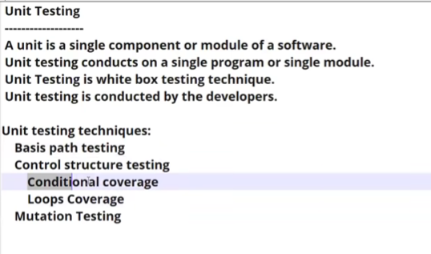
Unit Testing

Slide 5
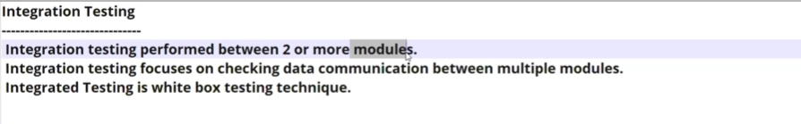
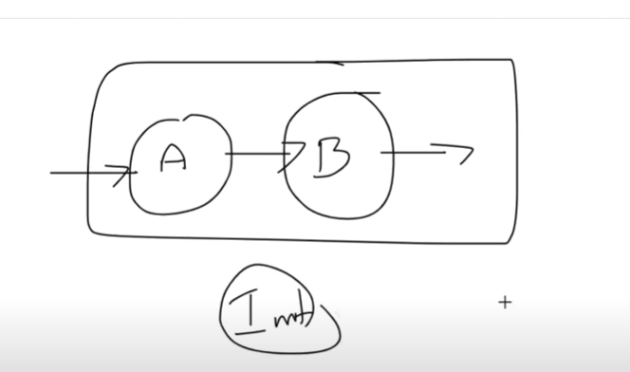
Integration Testing

Slide 6
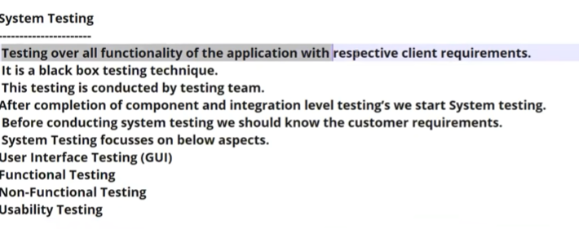
SYSTEM TESTING

Slide 7
UAT TESTING’
After the completion of the system testing , UAT team conducts acceptance testing in 2 levels
ALPHA TESTING : The customers will come back to the company and do some testing
BETA
TESTING : Install the software in user environment and do testing

Slide 8
Quality Management
Project Quality Management consists of the following major processes
Quality Planning (Planning Process)
Quality Assurance (Execution Process)
Quality Control (Control Process)
Quality Improvement.

Slide 9
Quality Assurance
Attempts defect prevention by concentrating on the process of producing the product rather than working on defect detection / correction after the product is built.
Quality Control
Attempts to build a product, test it for expected behavior after it is built and if expected behavior is not same as actual behavior of the product, fixes the product as is necessary and rebuilds the product.

Slide 10
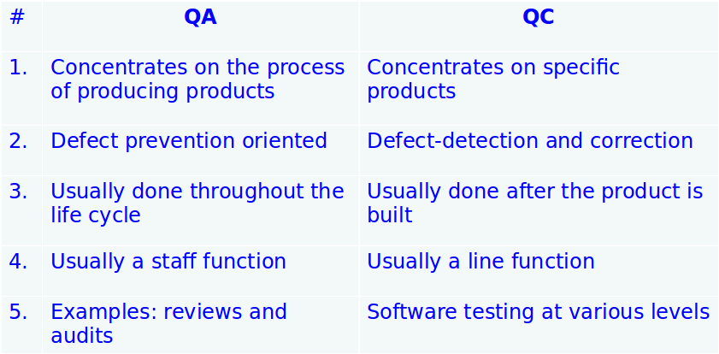
Difference between Quality Assurance and Quality Control

Slide 11
QA Vs QC
QA: QUALITY ASSURANCE
QA is process oriented ,define the process (high level management people)
QA will be involved throughout the development process
Focuses on building the quality
QA is for preventing the defects
QC: QUALITY CONTROL
-> Associated with people, testers
-> QC will focuses on testing the quality
-> QC is for detecting the defects/bugs
QE: QUALITY ENGINEERING: AUTOMATION TESTERS

Slide 12
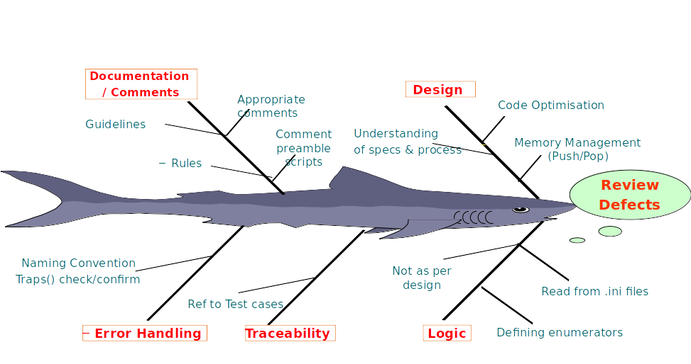
Quality Control- Fish Bone Analysis to review defects
Notes:
A cause and effect diagram, often called a “fishbone” diagram, can help in brainstorming to identify possible causes of a problem and in sorting ideas into useful categories. A fishbone diagram is a visual way to look at cause and effect.

Slide 13
Fish Bone Analysis (Cont.)
The team using the fishbone diagram tool should carry out these steps.
● Agree on the problem statement (also referred to as the effect). This is written at the mouth of the “fish.” Be as clear and specific as you can about the problem. Beware of defining the problem in terms of a solution (e.g., we need more of something).
● Agree on the major categories of causes of the problem (written as branches from the main arrow). Major categories often include: equipment or supply factors, environmental factors, rules/policy/procedure factors, and people/staff factors.
● Brainstorm all the possible causes of the problem. Ask “Why does this happen?” As each idea is given, the facilitator writes the causal factor as a branch from the appropriate category (places it on the fishbone diagram). Causes can be written in several places if they relate to several categories.
● Again asks “Why does this happen?” about each cause. Write sub-causes branching off the cause branches.
● Continues to ask “Why?” and generate deeper levels of causes and continue organizing them under related causes or categories. This will help you to identify and then address root causes to prevent future problems.
Ref: https://www.cms.gov/medicare/provider-enrollment-and-certification/qapi/downloads/fishbonerevised.pdf
Notes:
A cause and effect diagram, often called a “fishbone” diagram, can help in brainstorming to identify possible causes of a problem and in sorting ideas into useful categories. A fishbone diagram is a visual way to look at cause and effect.

Slide 14
Cost of Quality
The cost of quality is the total price of all efforts to achieve product or service quality. This includes the work to build a product or service that conforms to the requirements and all work resulting non-conformance to the requirements.
A typical project should have a goal of 3 to 5 percent of the total value devoted to the cost of a quality program.

Slide 15
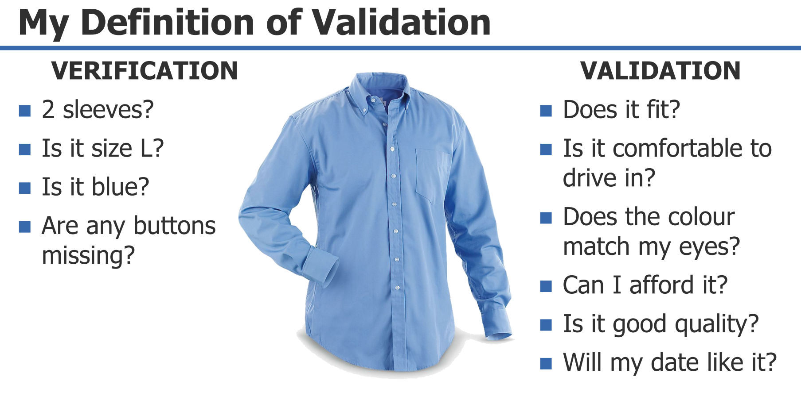
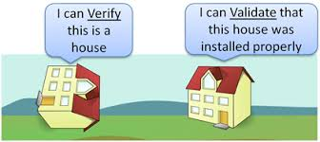
VERIFICATION AND VALIDATION

Slide 16
Process Model to Represent Different Phases
It is a way to represent any given phase of software development that effectively builds in the concepts of validation and verification to prevent and minimize the delay between defect injection and defect detection. In this model. each phase of a software project is characterized by following:
Entry
Task
Verification
eXit
This model is also known as ETVX.
‘

Slide 17
ETVX model applied to design
‘
Exit Criteria:
Complete traceability between design and SRS
Development team ready to start programming
Entry Criteria:
Approval of SRS by customer
Steps:
evolve an architecture
perform high level design
perform detailed/ low level design
write program spaces
Output:
Approved SRS
Input:
Approved SRS

